Slide 1




SHRI GURU GOBIND SINGH JI GOVT. COLLEGE,
PAONTA SAHIB, SIRMOUR (H.P)

Slide 2

B.A. 1ST YEAR
COURSE NAME: OLYMPIC MOVEMENTS AND ORGANIZATION OF TOURNAMENTS
COURSE CODE: PED102TH

Slide 3

FIXTURE,
ROLE OF SAI

Slide 4
TOPICS TO BE COVERED
KNOCK-OUT FIXTURES
ROLE OF SAI
KHELO INDIA PROGRAM

Slide 5
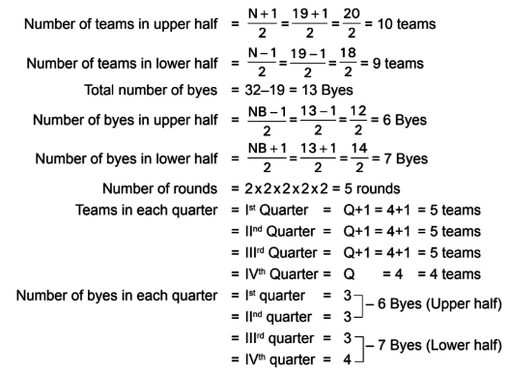
KNOCK-OUT FIXTURES
Fixture of 19 Teams on Knock-out Basis
Total number of teams=19
Total number of matches=19-1 =18

Slide 6
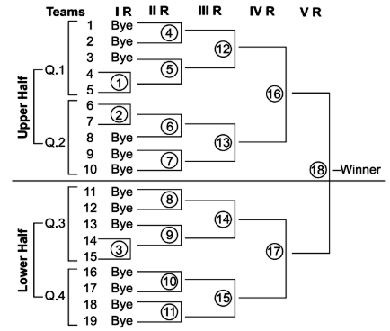

Slide 7
ROLE OF SAI
(SPORTS AUTHORITY OF INDIA)
The Sports Authority of India (SAI) is an apex National Sports body found in 1984 by the Ministry of Youth Affairs and Sports, Government of India for broad basing and bringing excellence in sports across India.
It's 9 Regional Centres which are located at Bengaluru, Gandhinagar, Chandigarh, Kolkata, Imphal, Guwahati, Bhopal, Mumbai, Lucknow, and Sonepat; and two Academic institutions viz. Netaji Subhash National Institute of Sports (NS NIS), Patiala and Laxmibai National College of Education (LNCPE), Thiruvananthapuram (Kerala).
Through NS NIS Patiala and a few of the regional centers at Bengaluru, Kolkata, and Thiruvananthapuram SAI offers a spread of courses in sports coaching and medicine, and SAI LNCPE, Thiruvananthapuram conducts graduate and post-graduate courses in education.

Slide 8
The Sports Authority of India (SAI) was established by the Government in 1984 as a Society under the Societies Registration Act, 1860, with the dual objective of broad-basing of sports and to realize excellence at the national and international level.
There's a provision to offer scholarships to sportspersons, consistent with their ability.
The merit list of sports achievements at the national level is ready for awarding scholarships.
SAI organizes nutrition camps to make awareness about the nutritional needs of varied age groups and organizes events to make and spread awareness about the importance of a well-balanced nutritious diet.
SAI has taken firm determination to popularize the indigenous games and martial arts.
Thanks to this, these games are organized within the north-eastern states of India. As a result, these games still exist in those parts of the country

Slide 9
KHELO INDIA PROGRAM
The Khelo India programme has been introduced to revive the sports culture in India at the grass-root level by building a strong framework for all sports played in our country and establish India as a great sporting nation.

Slide 10
Talented players identified in priority sports disciplines at various levels by the High-Powered Committee will be provided annual financial assistance of INR 5 lakh per annum for 8 years.
Khelo India School Games, which are a part of the Khelo India programme, are being held from 31st January to 8th February, 2018 in New Delhi.
Under-17 athletes have been invited to participate across 16 disciplines, which are as follows:
  Archery, Athletics, Badminton, Basketball, Boxing, Football, Gymnastics, Hockey, Judo, Kabaddi, Kho-Kho, Shooting, Swimming, Volleyball, Weightlifting, and Wrestling.

Slide 11


